Slide 1
Model Result Of Predictive
Customer Buying Behavior
By Omnia Hosny

Slide 2
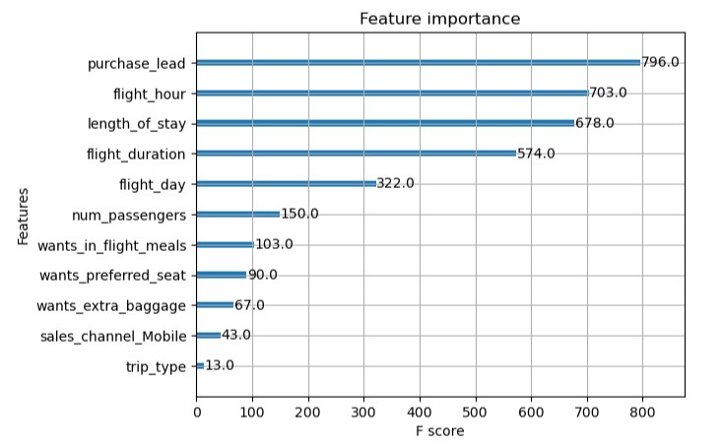
Results Of Model
From our feature importance of our model, we know that
The influencing factors of customers to complete their booking purchase_lead( number of days between travel date and booking date) and
length_of_stay (number of days spent at destination)
Then the area where the customer orders does not affect whether the customer will complete the booking or not

